Slide 1
TVR (Time-Variant Routing) Applicability draft-zdm-tvr-applicability
Contributors D. King C. Rotsos Lancaster University P. Liu China Mobile
T. Li
Juniper Networks
Authors L. Zhang
J. Dong Huawei
M. Boucadair Orange

Slide 2
Why This Document in TVR WG?
Specifically, the TVR WG will work on these items:
(1) Problem Statement and Use cases
…
(2) Requirements
…
(3) Information Model
…
(4) Data Model
..
(5) Applicability Statement
This document should provide an applicability statement on how the information and data models may be used, along with required ancillary IETF technology, to solve the use cases and requirements.
Excerpt from the TVR WG Charter

Slide 3
Main Document Contributions
Identify and walk through using a concrete use case
Document the applicability of TVR YANG modules (and other related ones)
Discussion time synchronization and protocol applicability
Identify and discuss operational considerations

Slide 4
What’s New in This Version?
Removed the schedule architecture section
Simplified the use case description
Modified Applicability Section to focus on the following questions:
In which scenarios TVR data models are applicable?
How to use TVR data models in these scenarios?
Added Time Synchronization section
Added Schedule Database section
Added Operation Considerations section

Slide 5
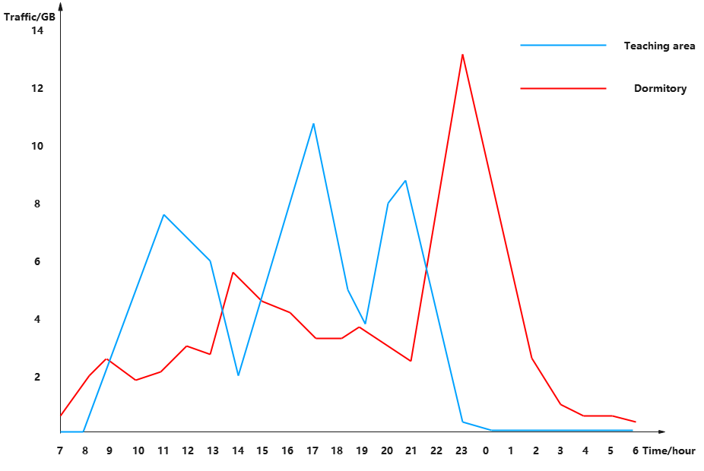
Use Case Examples
Tidal Network Example
Traffic on the network has an obvious tidal period, including heavy-traffic periods and light-traffic periods
Network topology change caused by specific traffic pattern.
The time duration of heavy traffic and light traffic are clearly identifiable
Students or employees work specific hours
Network change will occur twice per day
The switching time between the heavy-traffic period and the light-traffic period is well established
Working time and day of week are predictable
Is it sufficient to consider only tidal network use cases in Applicability I-D?
Tidal effect of traffic in campus network

Slide 6
Applicability of TVR YANG Model in Tidal Network(1/3)
In which scenarios TVR data model is applicable?
Schedule Generation Manner | Schedule Execution Manner | TVR YANG Applicable?
Centralized | Centralized | Yes
Distributed | Distributed | No
Centralized | Distributed | Yes
Managing Device
Schedule Generation
Schedule Distribution
Schedule Execution
Managed Device(s)

Slide 7
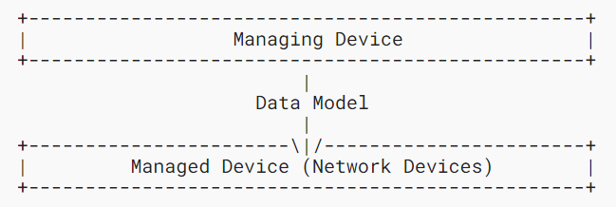
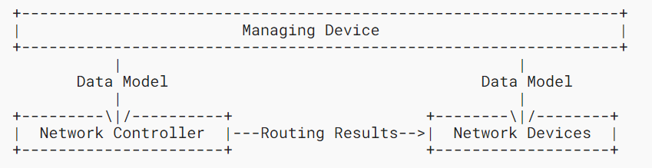
Applicability of TVR YANG Model in Tidal Network(2/3)
Network model and interactions
Distributed Model
Centralized Model
Generates and maintains schedules
Generates and maintains schedules
Execute schedules
Calculate routes
Execute schedules and routing results
Interactions
Managing devices deliver schedules to managed devices using the TVR YANG model
Interactions
Managing devices deliver node-specific schedules to network devices using the TVR Node YANG module
Managing devices deliver topology schedules controller using the TVR Topology YANG module
Network controllers deliver routing decisions to network devices using dedicated YANG modules

Slide 8
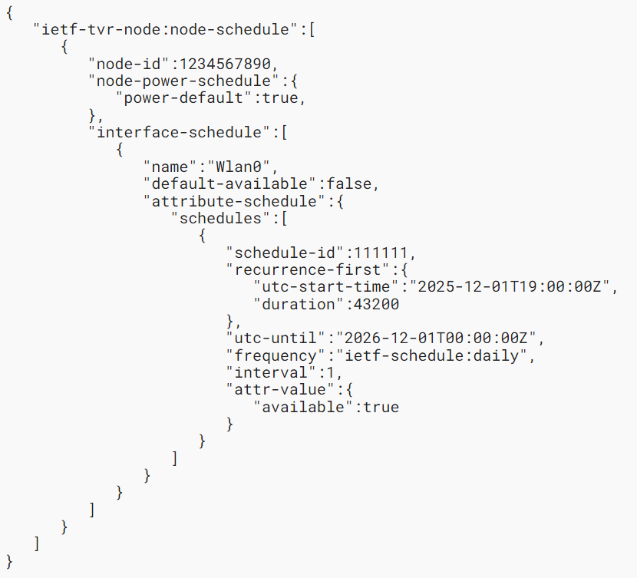
Applicability of TVR YANG Model in Tidal Network(3/3)
A JSON example to illustrate the use of “ietf-tvr-node” to shut down a wireless link from 19:00 to 7:00 every day.
Encoding of TVR YANG Model
TVR data model defines the following YANG modules:
“ietf-tvr-schedule” module contains the schedule YANG definitions;
“ietf-tvr-topology” module defines a network topology with a time-variant availability schedule;
“ietf-tvr-node” module is to be used to manage the scheduled attributes of a single node.
All of these modules are applicable in Tidal Network to manage devices and deliver topology information.

Slide 9
Management Protocols
NETCONF
Provides a robust mechanism for managing complex network configurations
Supports atomic transactions, which ensures schedules involving multiple resources are applied fully, preventing partial updates that could lead to configuration inconsistencies. This is important for TVR environments.
Supports the validation of configurations prior to commitment, allowing operators to verify the correctness of schedules before they are applied
RESTCONF
Provides a simpler, stateless method for interacting with network devices, suitable for use cases requiring lightweight, rapid configuration
Provides a streamlined approach to network configuration and management by RESTful interface over HTTP. It has advantages in scenarios where quick adjustments to schedules are needed or where integration with web-based or cloud-native systems is a priority
Summary
NETCONF would be the preferred protocol for large-scale, critical scheduling operations requiring validation and rollback mechanisms.
RESTCONF would be the preferred protocol for smaller-scale or isolated scheduling tasks.
RESTCONF would be preferrable between service/network orchestrators

Slide 10
Time Synchronization
Hardware-based protocols
Rely upon dedicated hardware to ensure clock synchronization, such as GPS and Precision Time Protocol (PTP)
Have higher precision and stability, but also have higher cost due to the dedicated Hardware
Appropriate for networks with critical time synchronization scenarios
Software-based protocols
Synchronize clocks through software packages running on systems, such as Network Time Protocol (NTP) and Simple Network Time Protocol (SNTP)
Simple and applicable to common hardware devices but have lower precision
Appropriate for most of the TVR use cases

Slide 11
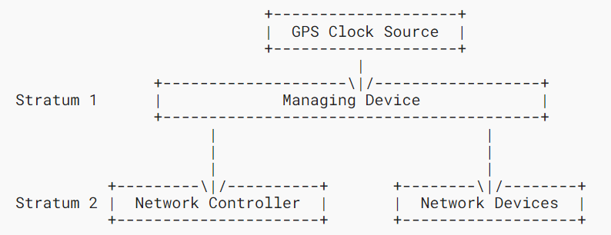
Time Synchronization in Tidal Network
Time synchronization precision requirements of tidal network : Second level
NTP
Uses a hierarchical structure of time sources. Each level of this hierarchy is termed a stratum
Have higher precision: it can realize the synchronization at tens of milliseconds level.
SNTP
Simplifies the complex NTP synchronization function and is suitable for networks with limited resources and loose precision requirements. The synchronization precision still can be guarded under seconds
Can be used as an alternative clock synchronization protocol for Tidal Network
NTP deployment case in tidal network

Slide 12
Schedule Database
Data Structure
Based on TVR YANG modules, the schedule database should contain four types of schedule entries:
Node power schedule entry
Interface schedule entry
Node schedule entry
Links schedule entry
Schedule Database Requirements
Schedule database should support “add”, “update”, and “delete” operations
When adding or updating a schedule entry, the execution node needs to check whether resource conflicts exist between the current schedule and existing schedules
Schedules are updated and deleted based on schedule IDs
Schedule IDs must be unique in a time-variant domain

Slide 13
Sample Operational Considerations
Coordinated Network Events
TVR often coordinates routing changes anticipating events like predictable link downtimes
Accurate Scheduling of Paths
‘TVR schedule’-capable nodes will dynamically adjust forwarding paths based on planned changes
Time-Stamped Data Models
TVR will require the use time-stamped data to make interface management decisions
Schedule Execution Considerations
A link coming up or a node joining a topology should not have any functional change until the change is proven to be fully operational
A link or node is to be removed from the topology, then the network should act before the anticipated change to route traffic around the expected topological change.

Slide 14
Security Considerations
The "Security Considerations" section of I-D.ietf-tvr-requirements outlines various threat vectors and categories specific to time-variant environments..
This part will provide detailed security techniques and best practices to address these challenges.
Notes:
The integration of time-variant mechanisms in network operations presents distinct security challenges that require thorough analysis to safeguard the network’s integrity, availability, and confidentiality.

Slide 15
Next Steps
Suggestions for other use cases to assess the applicability are welcome
Likewise, we welcome contributions to the operation and security considerations
Is the document a good start for the applicability item?
If so, we request to consider WG adoption

